Slide 1
Section 10.1
Parametric and Polar Curves; Conic Sections
“Parametric Equations; Tangent Lines and Arc Length for Parametric Curves”

Slide 2
All graphics are attributed to:
Calculus,10/E by Howard Anton, Irl Bivens, and Stephen Davis Copyright © 2009 by John Wiley & Sons, Inc. All rights reserved.”

Slide 3
Chapter Introduction
In this chapter, we will study alternative ways of expressing curves in the plane.
Curves described in component form (parametric curves)
Polar curves
Conic sections
You have seen all of these in previous years, and we will now find tangent lines, arc length, etc. associated with them.

Slide 4
Parametric Equations
Parametric equations express motion in such a way that the x- and y-coordinates, as functions of time, are:
x = f(t)
y = f(t)
The resulting curve (C) shows the trajectory of the particle described by the equations.
To graph a parametric equation, you may want to start by eliminating the parameter, or by making a table.
NOTE: t = time is the parameter for many, but it can be any independent variable that varies over some interval of real numbers.

Slide 5
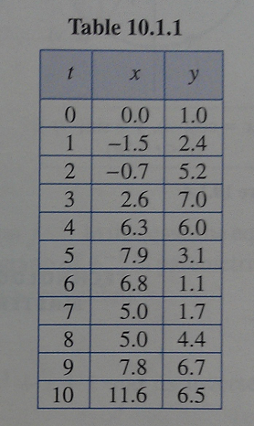
Example 1
Sketch the trajectory over the time interval [0,10] of the particle whose parametric equations of motion are:
x = t – 3sint and
y = 4 – 3cost.
Solution: Start by making a table and plotting points.
x = 0 – 3*sin(0) = 0
y = 4 – 3*cos(0) = 1

Slide 6
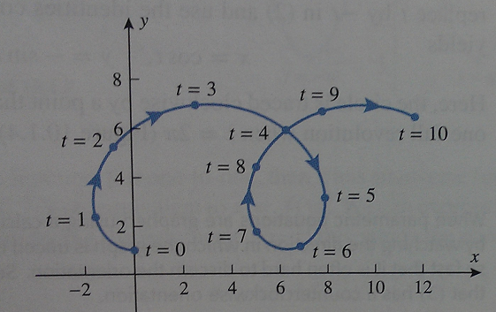
Example 1 con’t
After completing the table, connect the points with a smooth curve, indicate direction of travel, and label the points with their associated value(s) of t.
There is no t-axis in the picture.

Slide 7
Example 2
Find the graph of the parametric equations
x = cos t, y = sin t on the interval [0,$2π$].
Solution: It is often faster to graph by eliminating the parameter, t. For this example, we will use the Pythagorean identity $\sin^{2}$t + $\cos^{2}$t = 1 and substitution which gives $x^{2}$ + $y^{2}$ = 1 which is a circle.

Slide 8
Orientation
Orientation is the direction in which the graph is traced as the parameter increases.
Indicating this direction of travel on the graph is the difference between a curve and a parametric curve.
The orientation in example 2 was counterclockwise (see the arrow).
To reverse the orientation, we could replace t with –t in example 2.
This does not work for every parametric

Slide 9
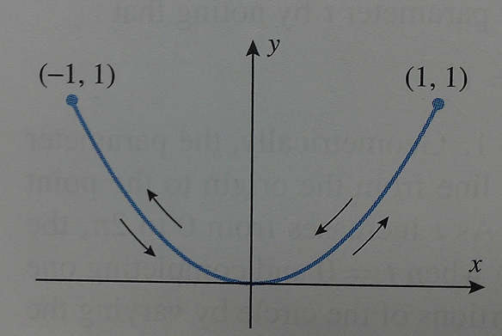
NOTE
Not all parametric equations produce curves with definite orientations; if the equations are badly behaved, then the point tracing the curve may leap around sporadically or move back and forth, failing to determine a definite direction.
Example: x = sin t, y = sin ² t
This has an orientation that
moves periodically back and
forth along the parabola.

Slide 10
Tangent Lines to Parametric Curves
When we have a curve given by parametric equations with continuous first derivatives with respect to t, we can find $\frac{dy}{dx}$ using the chain rule.
$\frac{dy}{dx}= \frac{\frac{dy}{dt}}{\frac{dx}{dt}}$ without eliminating the parameter.

Slide 11
Example
Find the slope of the tangent line to the unit circle x = cos t, y = sin t at the point where t = $\frac{π}{6}.$
Solution: $\frac{dy}{dt}$= cos t and $\frac{dx}{dt}$ = -sin t which gives us $\frac{dy}{dx}= \frac{\frac{dy}{dt}}{\frac{dx}{dt}}$ = $\frac{\cos{t}}{−\sin{t}}=−\cot{t}$
$\left.\frac{dy}{dx}\right|$ _{t =} $\frac{π}{6}$ = - cot $\frac{π}{6}$ = - $\sqrt{3}$

Slide 12
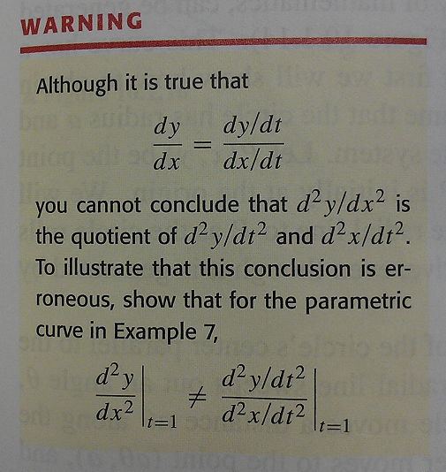
Finding $\frac{d2y}{dx2}$ Without Eliminating the Parameter
$\frac{d2y}{dx2}$ = $\frac{dy′}{dx}$ = $\frac{\frac{dy′}{dt}}{\frac{dx}{dt}}$
I will demonstrate what
the warning means in
class.

Slide 13
Example of $\frac{d2y}{dx2}$
Without eliminating the parameter, find a) $\frac{dy}{dt}$ and $b)\frac{d2y}{dx2}$ at (1,1) on the semicubical parabola (fancy name for the curve) when x = t², y = t³.
Solution: a) $\frac{dy}{dt}$= 3 t² and $\frac{dx}{dt}$ = 2t which gives us
$\frac{dy}{dx}= \frac{\frac{dy}{dt}}{\frac{dx}{dt}}$ = $\frac{\text{3 }\text{t}\text{2}}{\text{2}\text{t}}$ = $\frac{3}{2}$t
and since(1,1) occurs when t=1,
$\left.\frac{dy}{dx}\right|$ _{t =} $1$ = $\frac{3}{2}\left(1\right)=\frac{3}{2}$ +m, increasing

Slide 14
Example of $\frac{d2y}{dx2}$ con’t
b) $\frac{dy′}{dt}$ = the derivative of $\frac{dy}{dx}$ with respect to t = $\frac{3}{2}$
which gives us$\frac{d2y}{dx2}$ = $\frac{dy′}{dx}$ = $\frac{\frac{dy′}{dt}}{\frac{dx}{dt}}$ = $\frac{\frac{3}{2}}{2t}= \frac{3}{4t}$
and since(1,1) occurs when t=1,
$\left.\frac{d2y}{dx2}\right|$ _{t =} $1$ =$\frac{3}{4(1)}=\frac{3}{4}$ concave up

Slide 15
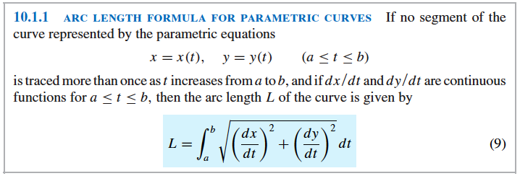
Arc Length of Parametric Curves
This arc length formula also comes from the distance formula, as we discussed last week.

Slide 16
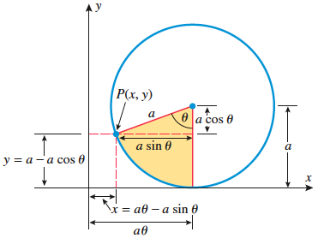
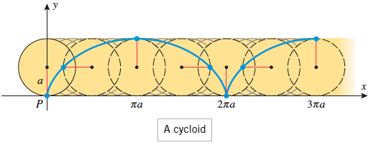
The Cycloid (The Apple of Discord)
There is some reading on pages 698-699 that might interest you regarding application of our work in section 10.1 that relates to the early study of differentiation and integration during the 1600’s and:

Slide 17
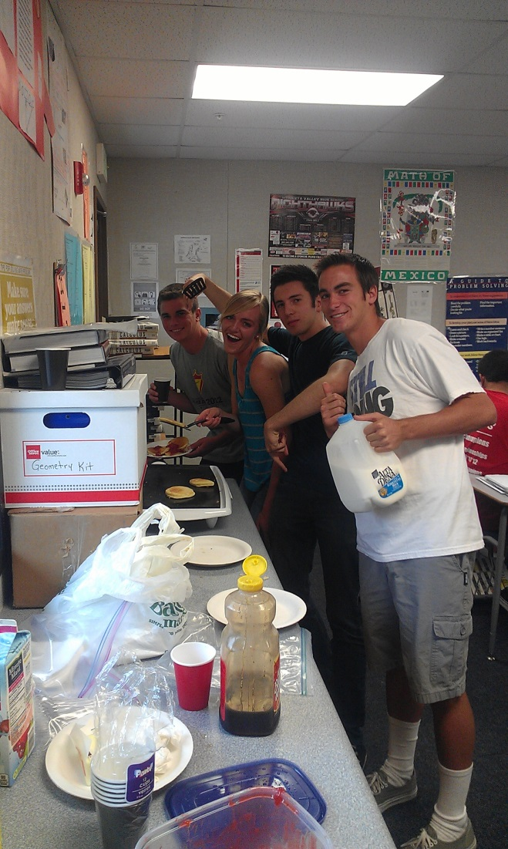
Oh, the memories… ☺

